Slide 1

Lecture
on
“Advanced Computer Architecture –TCS 704”
by
Akansha Gupta
DEPARTMENT OF COMPUTER SCIENCE AND ENGINEERING
GRAPHIC ERA DEEMED TO BE UNIVERSITY – 248002

Slide 2
Structural hazards

Slide 3
Pipelining hazards
Pipeline hazards prevent next instruction from executing during designated clock cycle
There are 3 classes of hazards:
– Structural Hazards:
• Arise from resource conflicts
• HW cannot support all possible combinations of instructions
– Data Hazards:
• Occur when given instruction depends on data from an instruction ahead of it in pipeline
– Control Hazards:
• Result from branch, other instructions that change flow of program (i.e. change PC)

Slide 4
How do we deal with hazards?
• Often, pipeline must be stalled
•Stalling pipeline usually lets some instruction(s) in pipeline proceed, another/others wait for data, resource, etc.

Slide 5
Stalls and performance
Stalls impede progress of a pipeline and result in deviation from 1 instruction executing/clock cycle
• Pipelining can be viewed to:
– Decrease CPI or clock cycle time for instruction
– Let’s see what affect stalls have on CPI…
• CPI pipelined =
– Ideal CPI + Pipeline stall cycles per instruction
– 1 + Pipeline stall cycles per instruction

Slide 6
Dependencies in a pipelined processor
There are mainly three types of dependencies possible in a pipelined processor. These are : 1) Structural Dependency 2) Control Dependency 3) Data Dependency
These dependencies may introduce stalls in the pipeline.

Slide 7
Structural dependency
This dependency arises due to the resource conflict in the pipeline. A resource conflict is a situation when more than one instruction tries to access the same resource in the same cycle. A resource can be a register, memory, or ALU.

Slide 8
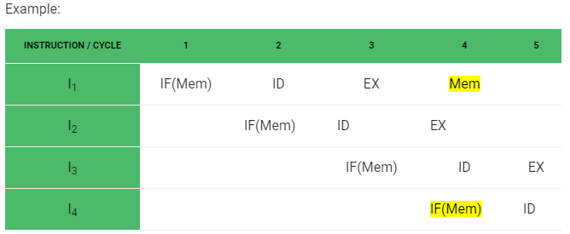
In the above scenario, in cycle 4, instructions I₁ and I₄ are trying to access same resource (Memory) which introduces a resource conflict.

Slide 9
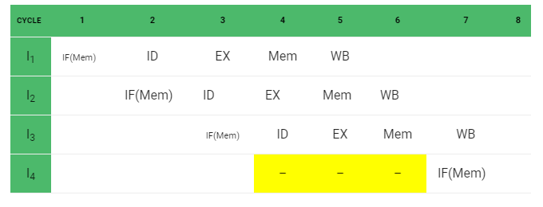
To avoid this problem, we have to keep the instruction on wait until the required resource (memory in our case) becomes available. This wait will introduce stalls in the pipeline as shown below:

Slide 10
Solution for structural dependency
To minimize structural dependency stalls in the pipeline, we use a hardware mechanism called Renaming. Renaming : According to renaming, we divide the memory into two independent modules used to store the instruction and data separately called Code memory(CM) and Data memory(DM) respectively. CM will contain all the instructions and DM will contain all the operands that are required for the instructions.

Slide 11
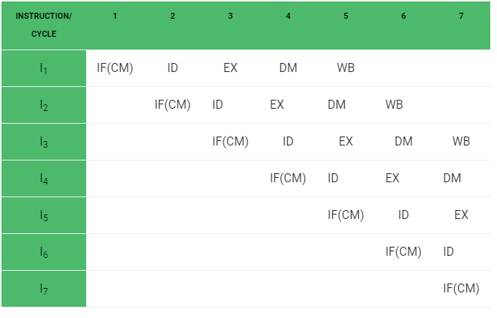

Slide 12
https://youtu.be/vghSd7LD3TQ
thanks

